Slide 2
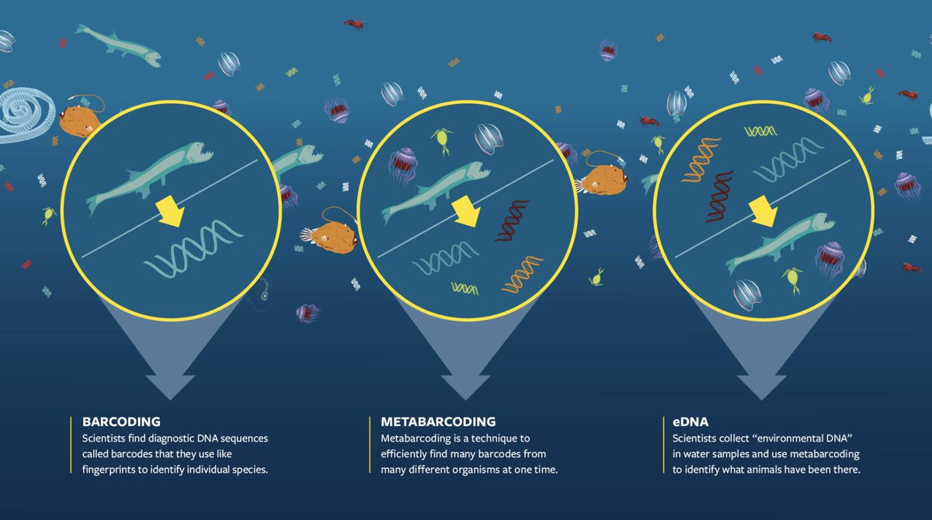
2
https://www.whoi.edu/oceanus/feature/round-up-the-unusual-suspects

Slide 3
Dos tipos de datos derivados del estudio de ADN ambiental
Una Especie
(targeted)
Múltiples especies
(non-targeted)
Diseño de primers específicos: Tarea no trivial, potencialmente lenta.
PCR cuantitativa (qPCR) o PCR digital (dPCR).
Permite la medición de la concentración de ADN en cada muestra
Construcción y uso de primers que amplifican múltiples especies.
Secuenciación masiva
Bioinformática para mapear secuencias a especies específicas.
Medición de la abundancia relativa de lecturas.

Slide 4
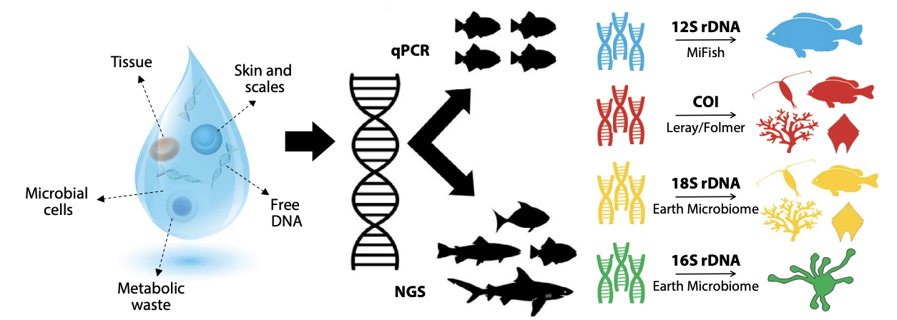

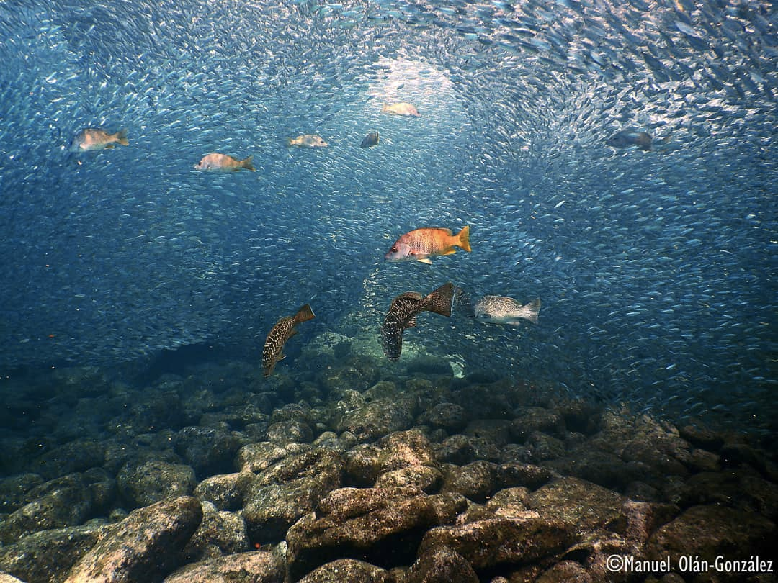
Métodos para el análisis de eDNA
Especie-específico
¿Qué queremos estudiar?
qPCR
dPCR
qPCR
dPCR
Metabarcoding
Especies particulares
Grupos de especies
4

Slide 5
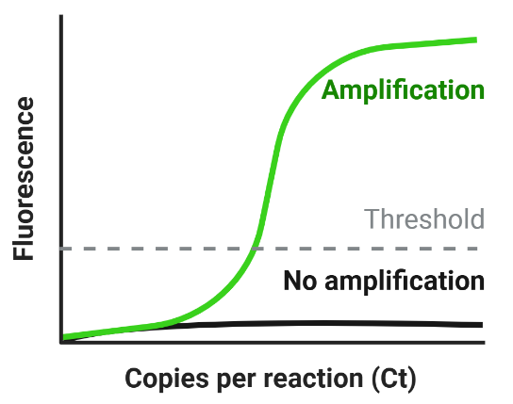

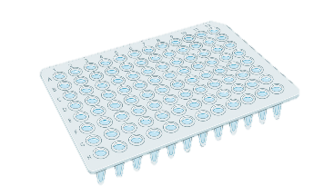

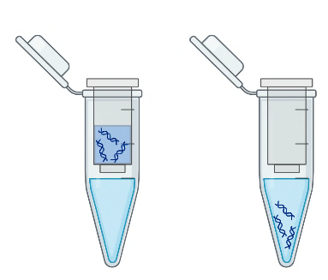
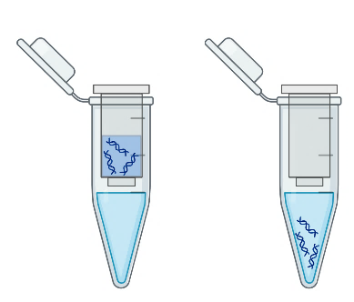

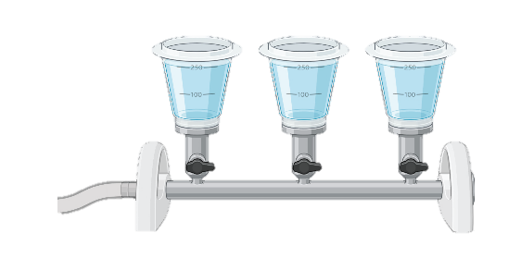
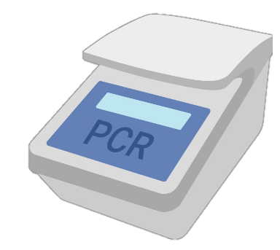
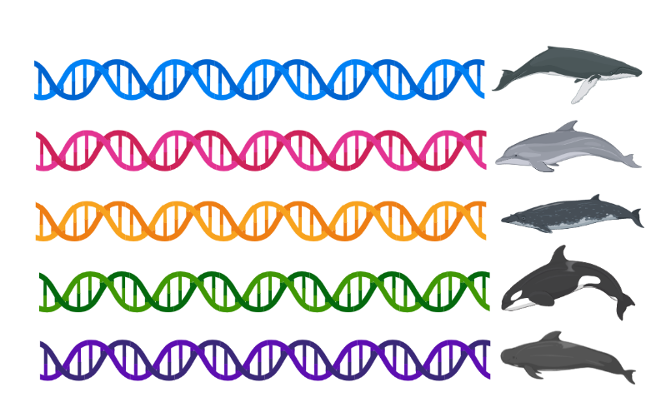
environmental DNA (eDNA)
Una especie
Múltiples especies
Collect
Filter
Preserve
Extract
Amplify
5
Imagen tomada de Shaffer et al. 2024

Slide 6
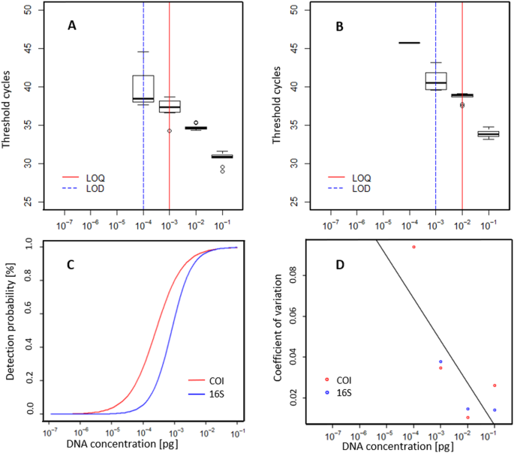
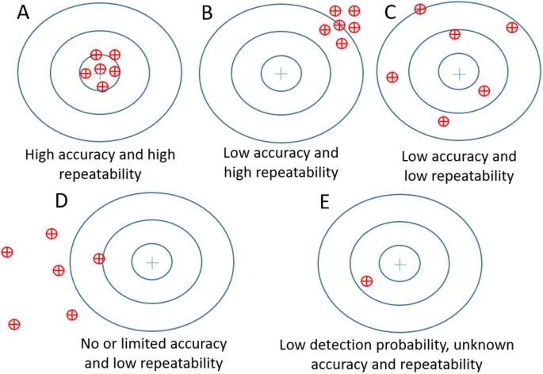
Mauvisseau et al. 2019
6
Notes:
Represent the theoretical variations in eDNA reliability: Blue circles represent a “target” whereby the inner centre circle would represent the higher accuracy. The red circles with crosses in the middle represent “replicate” samples (either natural or technical). Scenario in this figure are as follow: eDNA measurements with high accuracy and high repeatability (A), low accuracy and high repeatability (B), low accuracy and low repeatability (C) and low or limited accuracy and low repeatability. Panel E reflects a case where detection probability is low and hence the accuracy and repeatability of the analysis are unknown.
Assessment of standard curves used for quantifying M. margaritifera DNA as well as for determining the limit of detection (LOD) and limit of quantification (LOQ) with qPCR targeting the COI (A) and the 16S region (B). Standard curves were obtained with the same 1:10 dilution series from a starting concentration of 7.8 ng with 10 replicates per concentration. The threshold cycles are representing the minimum number of qPCR amplification cycles leading to positive detection. (C) The relationship between the detection probability and DNA concentration for the COI and 16s assays. (D) The coefficient of variation of eDNA measurements and its relation to DNA concentration in the standard curve. The black line represents the regression equation for the relationship. Data was pooled from both assays as results did not diverge significantly between methods.

Slide 7
DNA barcoding y barcodes
Sensu stricto:
Identificación de organismos a nivel de especie usando un fragmento de DNA estándar.
Sensu lato:
Identificación de organismos a cualquier nivel taxonómico usando cualquier fragmento de DNA.

Slide 8
Métodos para el análisis de eDNA
Ensayo de detección especie-específico
qPCR
dPCR
NGS
Metabarcoding
8
Chavez et al. 2021
Notes:
Environmental DNA (eDNA) is emerging as a powerful tool for community assessment and monitoring that holds the promise of revolutionizing the study of marine biodiversity. By providing information on species occurrence across taxonomic groups and by alleviating many of the logistical hurdles of sample collection, eDNA is rapidly increasing the breadth and depth of data available to scientists and resource managers. Environmental DNA methods offer a number of important advantages over traditional techniques, including non-invasive sampling, reduced cost and effort, and increased detection sensitivity (Bohmann et al., 2014; Rees et al., 2014; Valentini et al., 2016). Because of this, eDNA is increasingly being used to document marine species distribution and habitat use (Fig. 1). By leveraging advances in next-generation DNA (NGS; or massively parallel) sequencing, eDNA metabarcoding can be used to simultaneously detect large numbers of taxa, offering the opportunity to characterize and track community-level biodiversity from a single environmental sample. However, significant concerns regarding the limitations of various approaches must be addressed to ensure data quality and accurate comparison across datasets.
Current analytical techniques for eDNA fall into two broad categories: (1) those that target a species directly (e.g., via quantitative polymerase chain reaction, or qPCR, to detect a genetic signature of a specific organism), and (2) those that use metabarcoding to target broad groups of taxa (e.g., bacteria, phytoplankton, invertebrates, vertebrates)

Slide 9
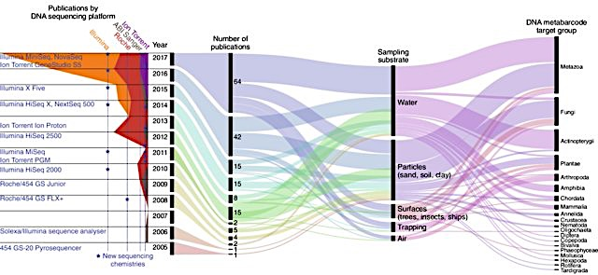
¿De dónde surge la técnica de metabarcoding de ADN?
Secuenciación masiva
y
Herramientas bioinformáticas
DNA barcoding
METABARCODING
Región de DNA estándar para la identificación de especies Hebert 2003
COX I animales
rbcL plantas
ITS hongos
+
=
9

Slide 10
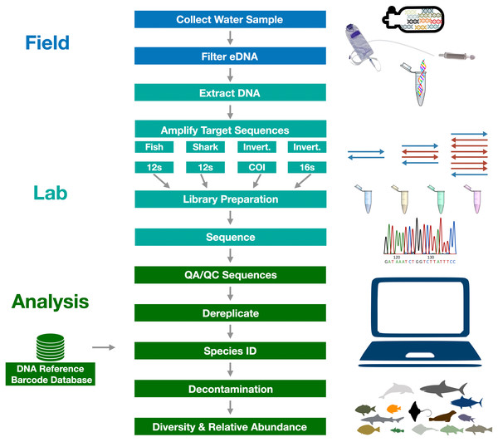
Gold et al. 2022
10
Notes:
Gold Z, Wall AR, Schweizer TM, Pentcheff ND, Curd EE, Barber PH, et al. A manager’s guide to using eDNA metabarcoding in marine ecosystems. PeerJ. 2022;10: e14071.

Slide 11
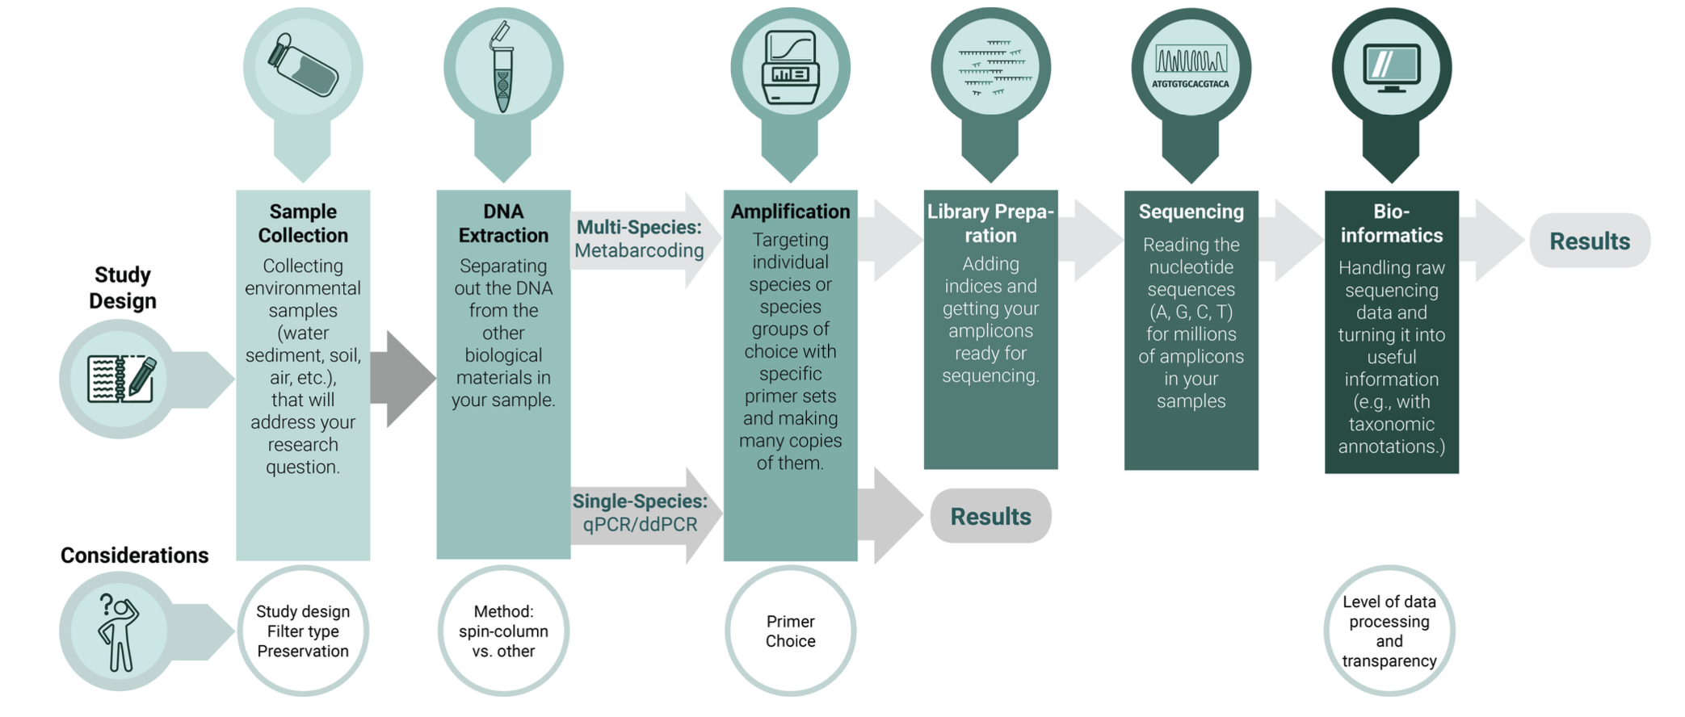
Flujo de trabajo general
11

Slide 12
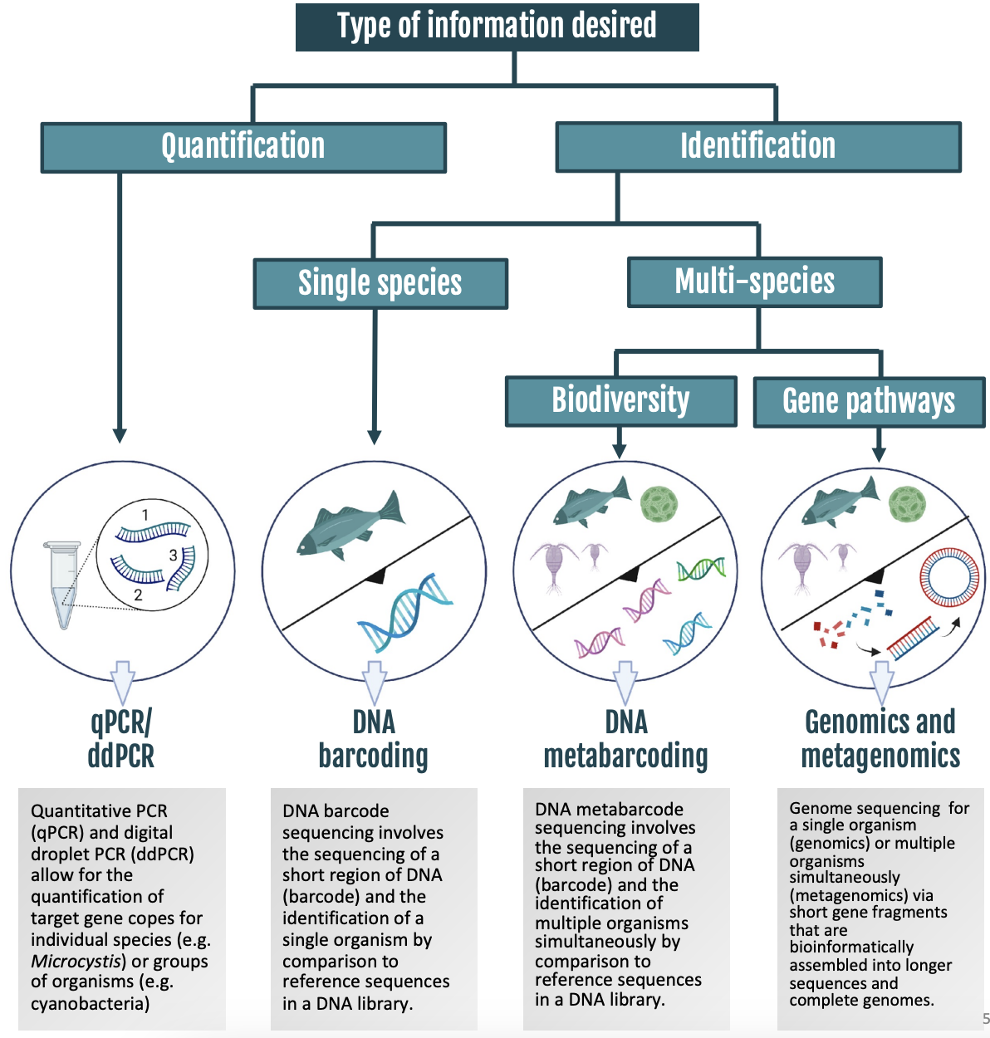
12
Notes:
En esta diapositiva se distinguen dos enfoques fundamentales en el análisis de eDNA. Por un lado, tenemos el enfoque dirigido o 'targeted', que se centra en detectar una especie específica mediante el diseño de primers muy selectivos, y que se utiliza junto con técnicas de PCR cuantitativa o digital para medir la concentración de ADN en cada muestra. Por otro lado, está el enfoque no dirigido o 'non-targeted', que utiliza primers universales para amplificar ADN de múltiples especies, seguido de secuenciación masiva y análisis bioinformático. Este último nos permite evaluar la abundancia relativa de cada especie dentro de la muestra y obtener una visión global de la biodiversidad presente

Slide 13
Al igual que todos los métodos de detección, los métodos basados en eDNA tienen sesgos. Hay que identificarlos para mitigar en mayor medida, así como para conocer las limitaciones y contribuciones de nuestros estudios.

